Slide 1
Environmental Services Commission
City of Tacoma | Environmental Services Department
Environmental Services Commission
May 12, 2022
Notes:
Template Read-Me
Do not insert animations or slide transitions into your presentation.
Use only sans serif fonts (i.e.: Arial, Tahoma, Helvetica).
Fonts must be between 24 points and 32 points in size. The minimum point size allowed is 18.
Avoid having too much text.
If the text flows outside the safe title area, split the information into two or more slides.
Pictures with white backgrounds should be toned down by right clicking the mouse on the picture, then selecting Format Picture, lower the brightness by 10%.
Ensure graphics (pictures, charts) are high resolution so they can be easily viewed on screen.
The Safe Area grid lines that you see on the background should be removed when your presentation is completely formatted.
To remove the grid lines: Select the View tab. On the left side of the upper tool bar, click on Slide Master. Select the top most slide in the list. (You may need to scroll)
To select the Safe Area we suggest clicking on the upper left corner of the object. Once it highlights, press delete. Save your presentation.
Alternatively you may hide the Safe Area by clicking Hide Background Graphics in the Design tab for each slide in your presentation. (However, make sure this action does not also affect other graphics you have added to your presentation.)

Slide 2
Agenda
Welcome
Approval of Minutes
Updates to Open Public Meetings Act
Overview of Asset Management & Capital Projects
Other Items of Interest
Adjournment

Slide 3
Updates to Open Public Meetings Act
Updates to OPMA effective June 9
Potential amendment to by-laws:
    Future meetings: In-person, virtual, or hybrid
    Requirement for physical location for public
    Public Comment: Written, oral, or both

Slide 4
Updates to Open Public Meetings Act (Cont.)
Oral Comment:
    Determine how much time allowed
      Need sign-in sheet and timer
    Comments restricted to agenda items
    Comments heard at the beginning of the meeting prior to presentations
      Agenda posted online at least 24 hrs. prior
    Commissioners do not respond or engage
Written Comment:
    Determine deadline for submissions
    Written comments transmitted to commissioners prior to meeting
    Comments restricted to agenda items
    Comments published online in meeting minutes

Slide 5
Updates to Open Public Meetings Act (Cont.)
Other
    The public can now subscribe to receive meeting notifications by signing up at cityoftacoma.org/esc
    ESC will vote on amendments to by-laws at meeting on June 9
    ESC Staff will meet with Chair/Vice prior to June 9 meeting

Slide 6
Capital Project Overview
City of Tacoma | Environmental Services
Environmental Services Commission
May 12, 2022
Karen Bartlett, P.E.
Principal Engineer
Teresa Dressler, P.E.
Professional Engineer
Lewis Griffith
Division Manager, SWM
Notes:
Objective of presentation
Provide understanding of the proposed WW and SW CIP and basis
Can’t talk about CIP without talking about asset management also, since asset mgt feeds the CIP!
Two components of presentation
Asset Management Overview – this is the basis for the CIP
Main components of the CIP with a couple projects highlighted from with each CIP category

Slide 7
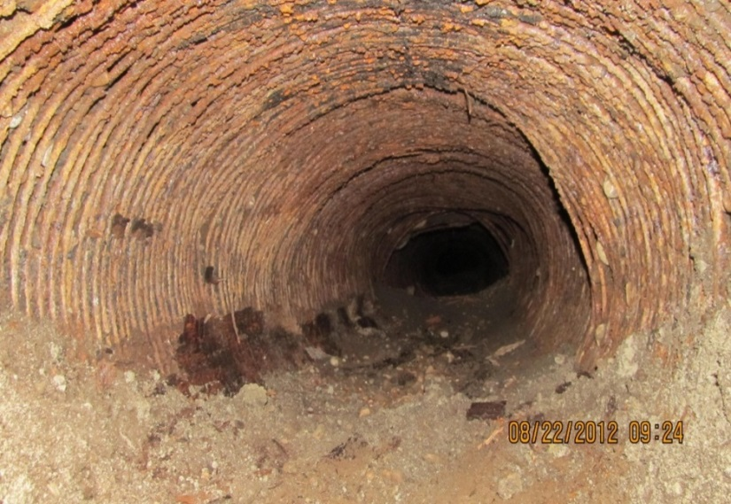
Asset Management Basics
Inventory
  What do we own?
Likelihood of Failure
  What condition is it in?
Consequence of Failure
  What are the impacts if it fails?
Risk = Likelihood of Failure x Consequence of Failure
  How do we mitigate risks?
  Funding
  How do we pay for it?
Notes:
Focus on existing assets...
An integrated set of processes to minimize life-cycle costs of infrastructure assets, at an acceptable level of risk, while continuously delivering levels of service.

Slide 8
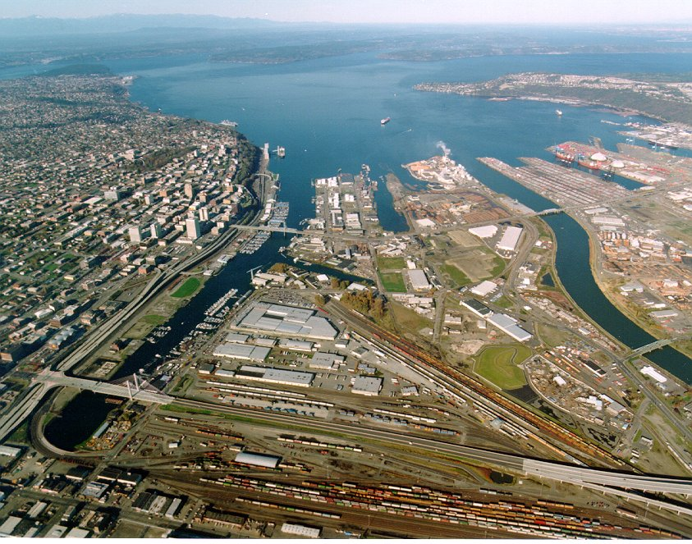
ASSET INVENTORY
Wastewater
  700 miles pipe
  Mechanical/electrical equipment
    1,550 each - pump stations
    6,300 each - treatment plants
Stormwater
  555 miles pipe
  32 Holding Basins/Ponds
  400 Treatment Devices
Solid Waste
  135 acres landfill cap
  Onsite Facilities
Notes:
Tell the story that we have significant infrastructure that we must maintain.
Transition to next slide that gives the principals behind our asset management program.

Slide 9
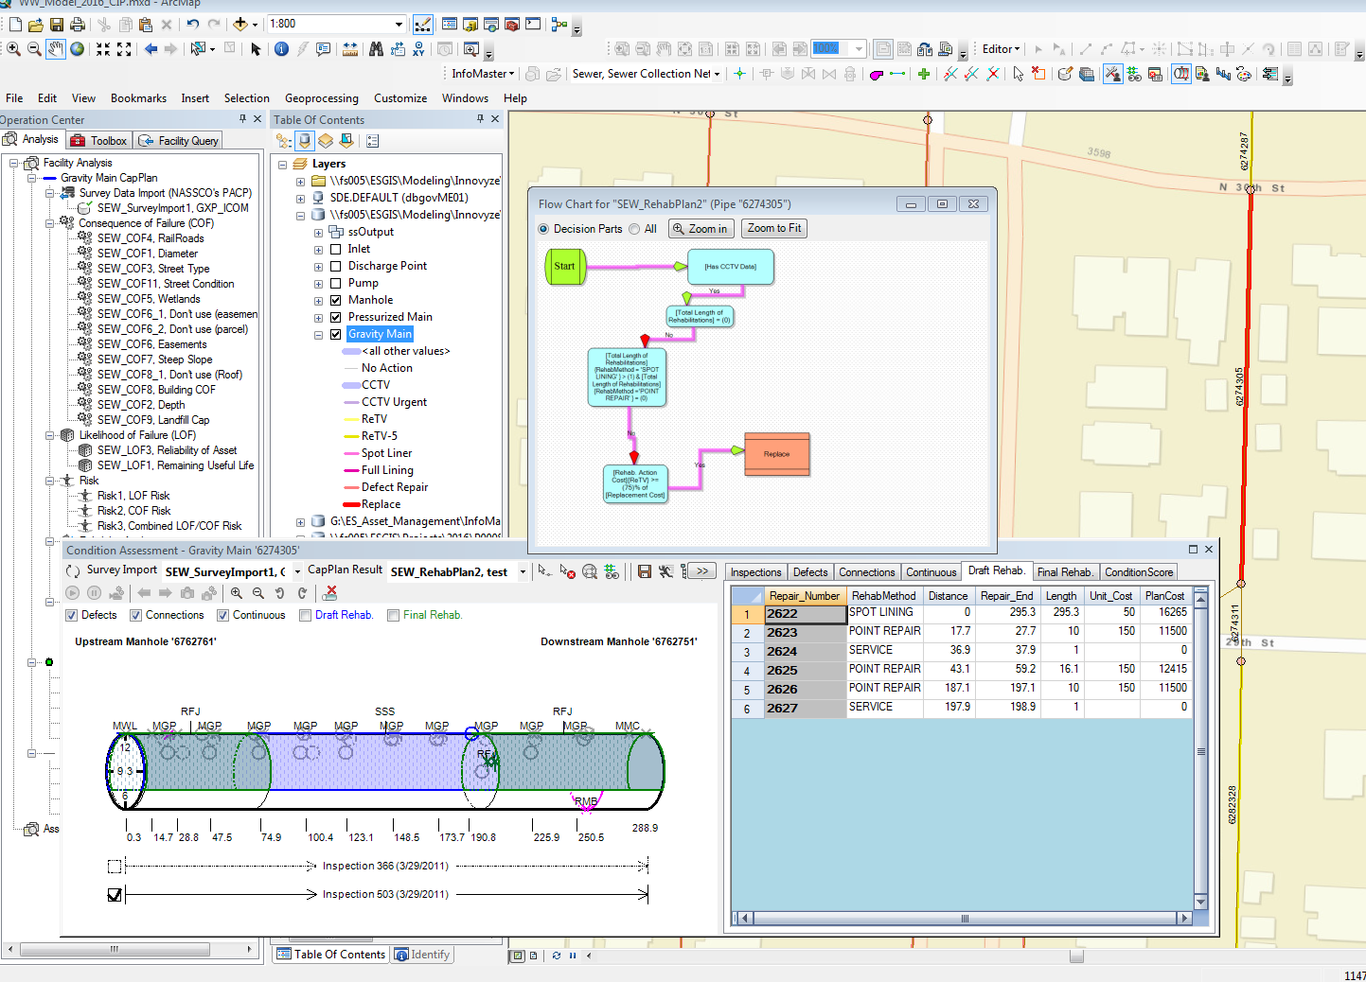
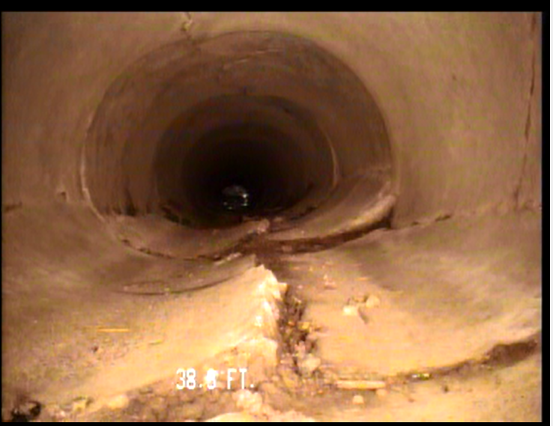
LIKELIHOOD OF FAILURE
Maintenance History
  Preventative & Corrective
Video inspections
Modeling
Notes:
To give you an example of what we look at when we evaluate LOF for collection systems, we are looking primarily at the maintenance history and our video inspection data. If we don’t have video inspection data, we must rely on the age of the asset (which we’ve founds isn’t a great indicator).
During video inspection, we get detailed information on the pipe condition (codes entered by the TV operator). These codes tell us the pipe (cracking, holes, exposed aggregate) and give us an indication of how likely it is to fail.

Slide 10
LOF – CONDITION ASSESSMENTS
Notes:
Here is some background history on our video inspection process for our 1200 miles of pipes. We are now over 90% for both storm and sanitary and working our way toward 100%.
We also re-inspect pipes as part of our basin cleaning work. We decide which pipes need re-inspection based on the pipe’s age (older pipe more frequent inspections), past maintenance actions after our last TV, and recent customer issues with the main.
Were inspecting prior to 2005…in VHS at that time. Now moved electrocinc.

Slide 11
LOF – WASTEWATER PIPE AGE

Slide 12
LOF – STORMWATER PIPE AGE

Slide 13
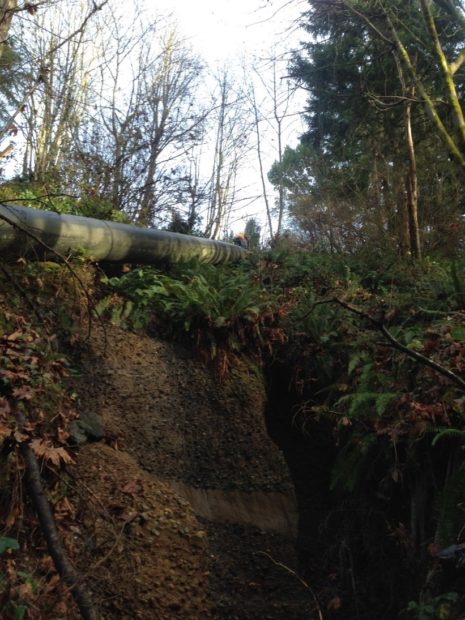
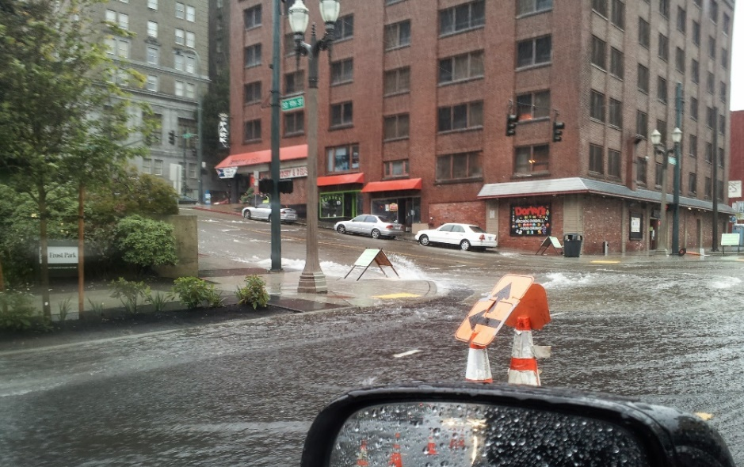
CONSEQUENCE OF FAILURE
Location
  Steep slopes
  Under buildings/highways/railroad tracks
  Wetlands
  Flooding impact
  Size of Pipe
Notes:
To give you an example of what we look at when we evaluate LOF for collection systems, we are looking primarily at the maintenance history and our video inspection data. If we don’t have video inspection data, we must rely on the age of the asset (which we’ve founds isn’t a great indicator).
During video inspection, we get detailed information on the pipe condition (codes entered by the TV operator). These codes tell us the pipe (cracking, holes, exposed aggregate) and give us an indication of how likely it is to fail.

Slide 14
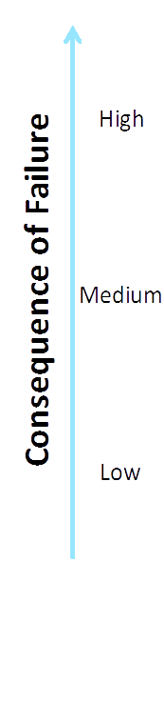
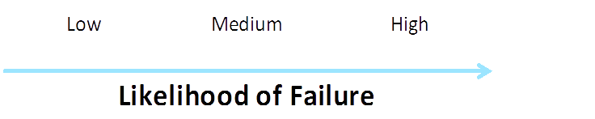
RISK EVALUATION
Notes:
This is an example of the a Consequence of Failure vs. Likelihood of Failure
We have a similar scoring and COF vs. LOF for each of the other categories of assets (Pump Stations, NETP, & CTP).
The bottom line here is that we should be focusing our CIP efforts on assets that are in the upper right quadrant, (or adjacent)
Look at the CTP LOF vs COF…………….
This scatter plot also gives us a good “dashboard” of the condition of assets within this category.

Slide 15
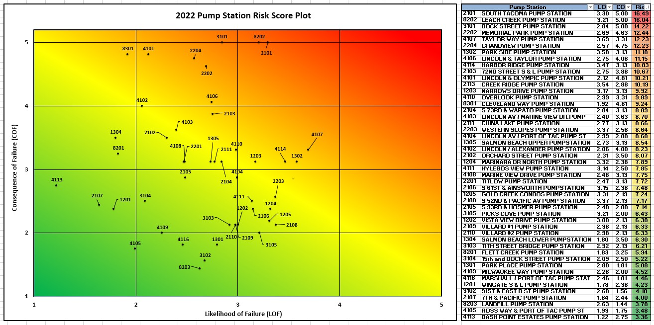
PUMP STATION RISK PLOT

Slide 16
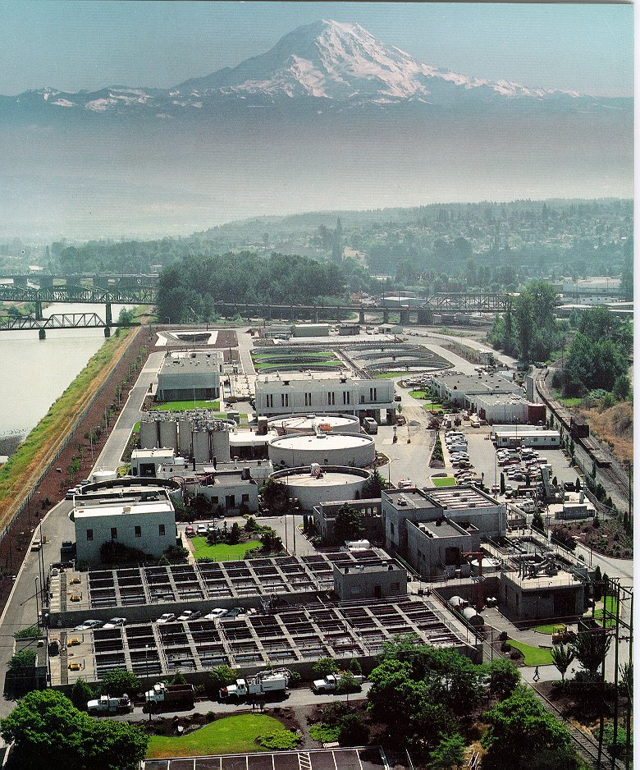
WASTEWATER CATEGORIES & COSTS
6 Year Total Cost (2023-2028) = $173M
Annual Average = $28.8M
Rolling Stock & Misc. $9.3M
Central Treatment Plant Improvements $42.1M
North End Treatment Plant Improvements $18.5M
Collection System Improvements
$94.4M
Pump Station Improvements $8.4M
Notes:
This is a snap shot summary of the different traditional capital project categories. The numbers shown are draft and may be further revised after we evaluate what we can afford with rates.

Slide 17
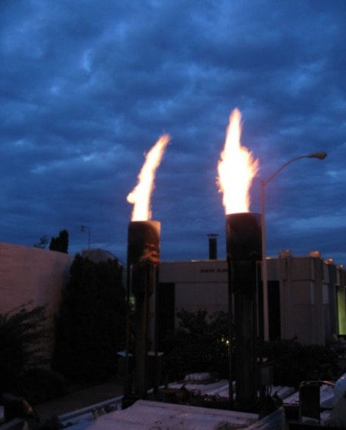
FUTURE SIGNIFICANT WASTEWATER PROJECTS
CTP Concrete Repairs/Coatings
$33M
2023-2028
NETP Trickling Filter Project
$14.0M
2023-2024
Approximately 18 Miles of Misc. Underground Pipe Improvements
$94.4M
2023-2028
South Tacoma Pump Station Rehabilitation
$6.5M
2023
Notes:
EW Slide
CTP Concrete Repairs/Coatings – We had a concrete and structural steel assessment of the CTP and NETP that wrapped up in 2020. This $33M reflects projects on our clarifiers, UNOX tanks, primary settling tanks, and themophilic digesters to repair concrete and install coatings as needed. This is phased in over time since we are generally limited to doing this work in summer (when flows are lower) and doing only 1 tank at a time.
NETP Trickling Filter Project:
Existing Biofilter Media is nearly 30 years old and should be replaced in the next 2-4 years.
Original plan was to replace media in the existing Biofilter, which would require a temporary treatment option. Temporary treatment options were found to be too expensive ($4M) and would not guarantee adequate treatment.
Second Biofilter had the same cost as the temporary treatment option and replacement of the media. (approx. $6M)
Second Biofilter provides:
Maintains secondary treatment at NETP.
Redundant secondary treatment – cheaper media replacement in the future for the City
Sets up City for future regulatory requirements (e.g. nutrients)
Collection System Replacement & Rehabilitation -

Slide 18
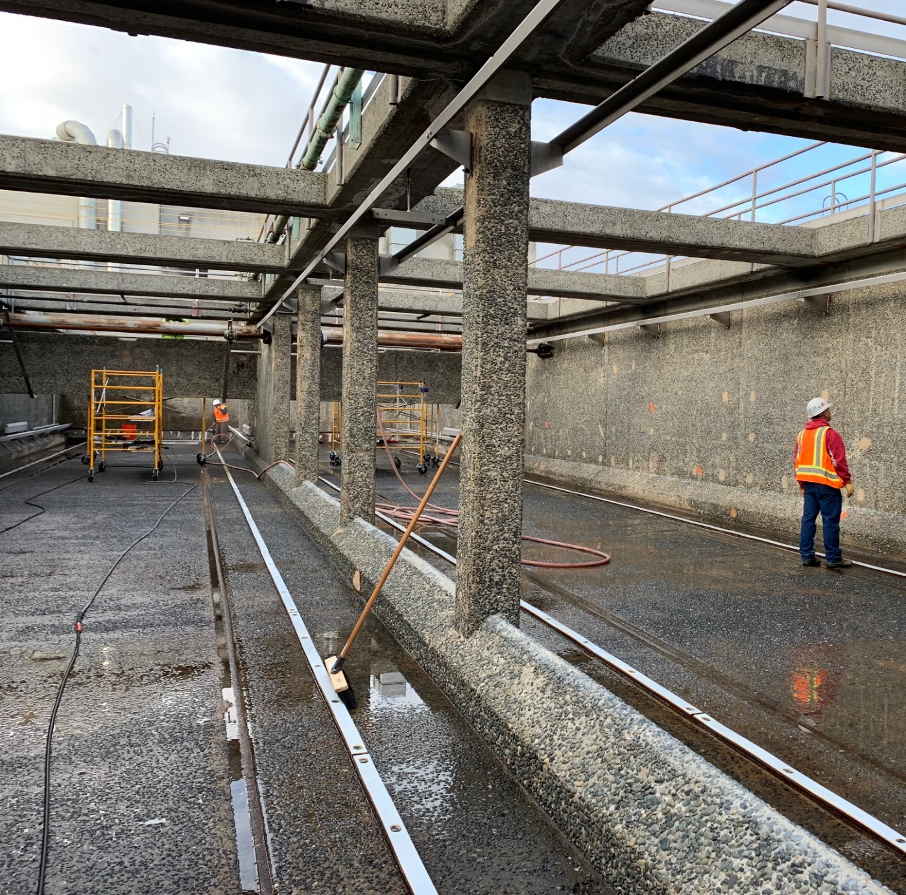
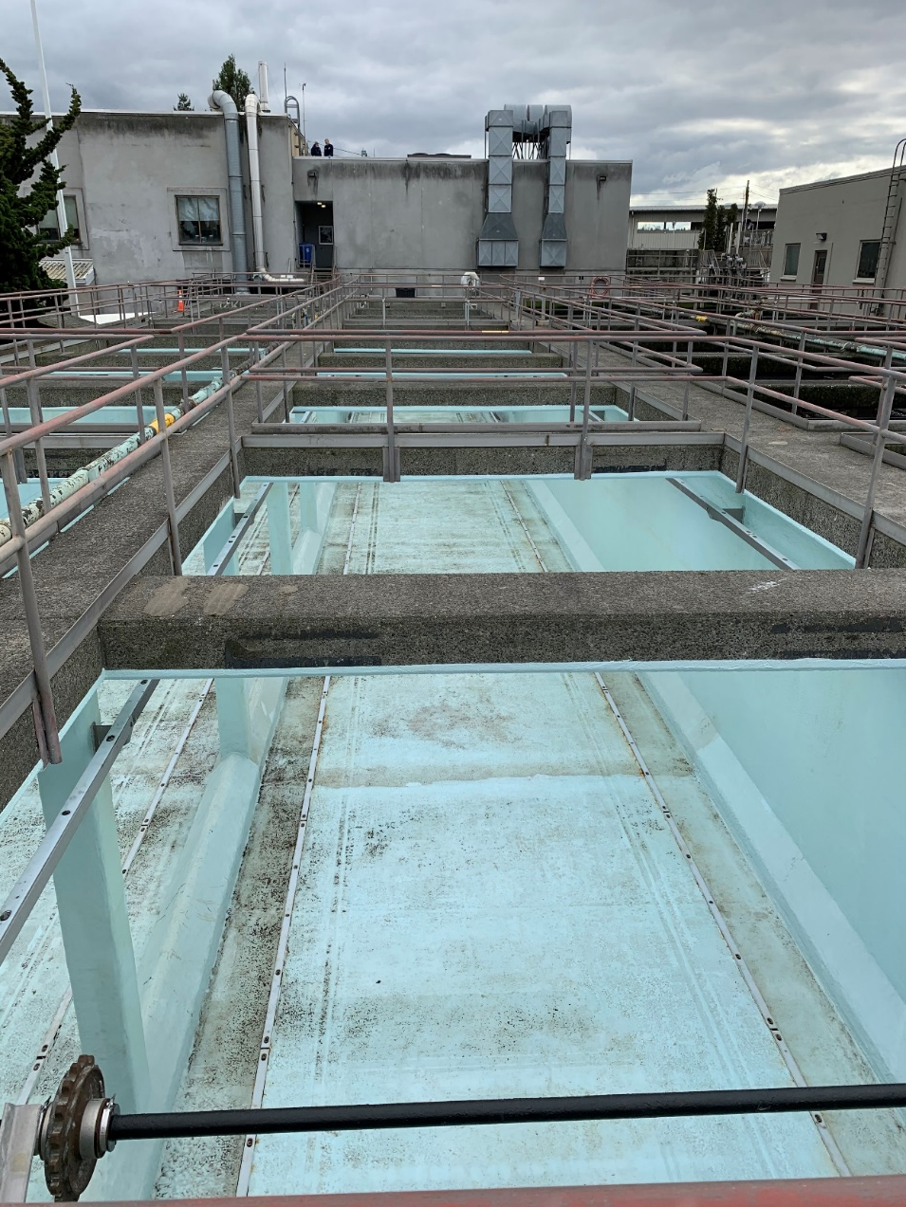
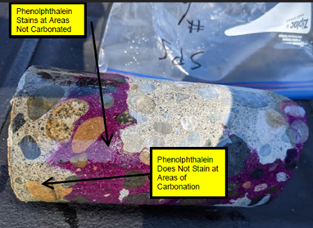
Concrete Rehab – Sedimentation Tank Project
Notes:
Example of the sed tank rehab project that recently occurred. Many of the items identified with the concrete/structural steel project will be similar. Crack filling and then a coating.

Slide 19
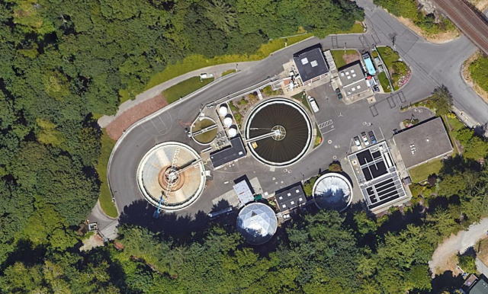
North End Wastewater Treatment Plant Second Trickling Filter Project
Second Tricking Filter
Existing Tricking Filter
Notes:
Existing Biofilter Media is nearly 30 years old and should be replaced in the next 2-4 years.
Original plan was to replace media in the existing Biofilter, which would require a temporary treatment option. Temporary treatment options were found to be too expensive ($4M) and would not guarantee adequate treatment.
Second Biofilter had the same cost as the temporary treatment option and replacement of the media. (approx. $6M)
Second Biofilter provides:
Maintains secondary treatment at NETP.
Redundant secondary treatment – cheaper media replacement in the future for the City
Sets up City for future regulatory requirements (e.g. nutrients)
Existing Biofilter Media Needs to be Replaced
Temporary Treatment was Evaluated:
Could not guarantee consistent treatment
Expensive option
Second Biofilter Alternative was Selected:
Maintains Full Treatment at NETP
Redundancy for Future Media Replacement
Future Treatment Options Flexibility

Slide 20
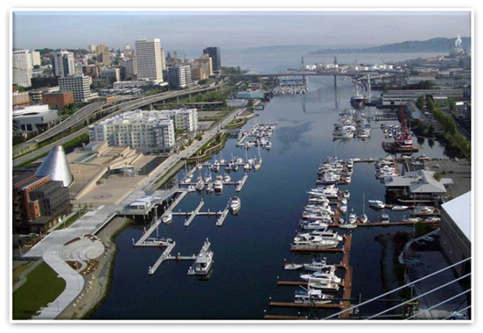
STORMWATER CATEGORIES & COSTS
6 Year Total Cost (2023-2028) = $114M Annual Average = $19.0M
Facility Improvements $8.4M
Rolling Stock & Misc. $4.7M
Treatment & Low Impact Development $39.8M
Collection System Improvements $61.0M
Notes:
This includes $12M in DOE grant funding and SRF Loans.
This is a snap shot summary of the three different traditional capital project categories
Facility – things like pump stations (4 major ones) and holding basins (couple dozen of these – regional to neighborhood sized)
Collection – Typical underground conveyance system work – 400 miles pipe; includes new pipe
Treatment & Low Impact Development – provide storm water treatment, flow reduction (pervious pavement)….. Next slide has examples from this year of these types of projects.

Slide 21
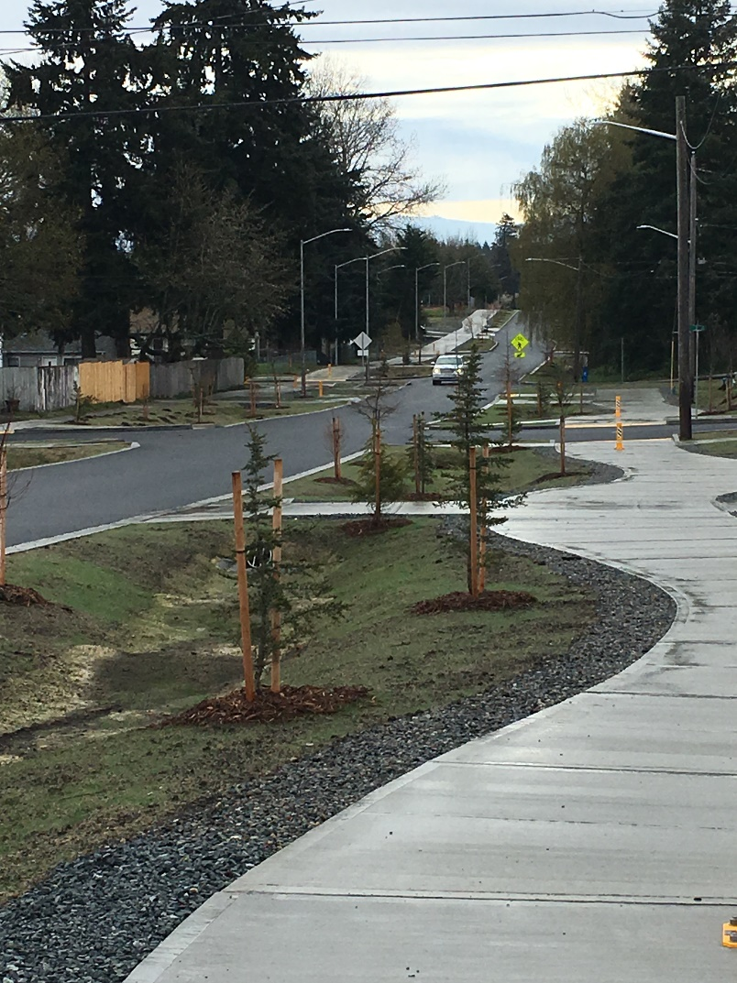
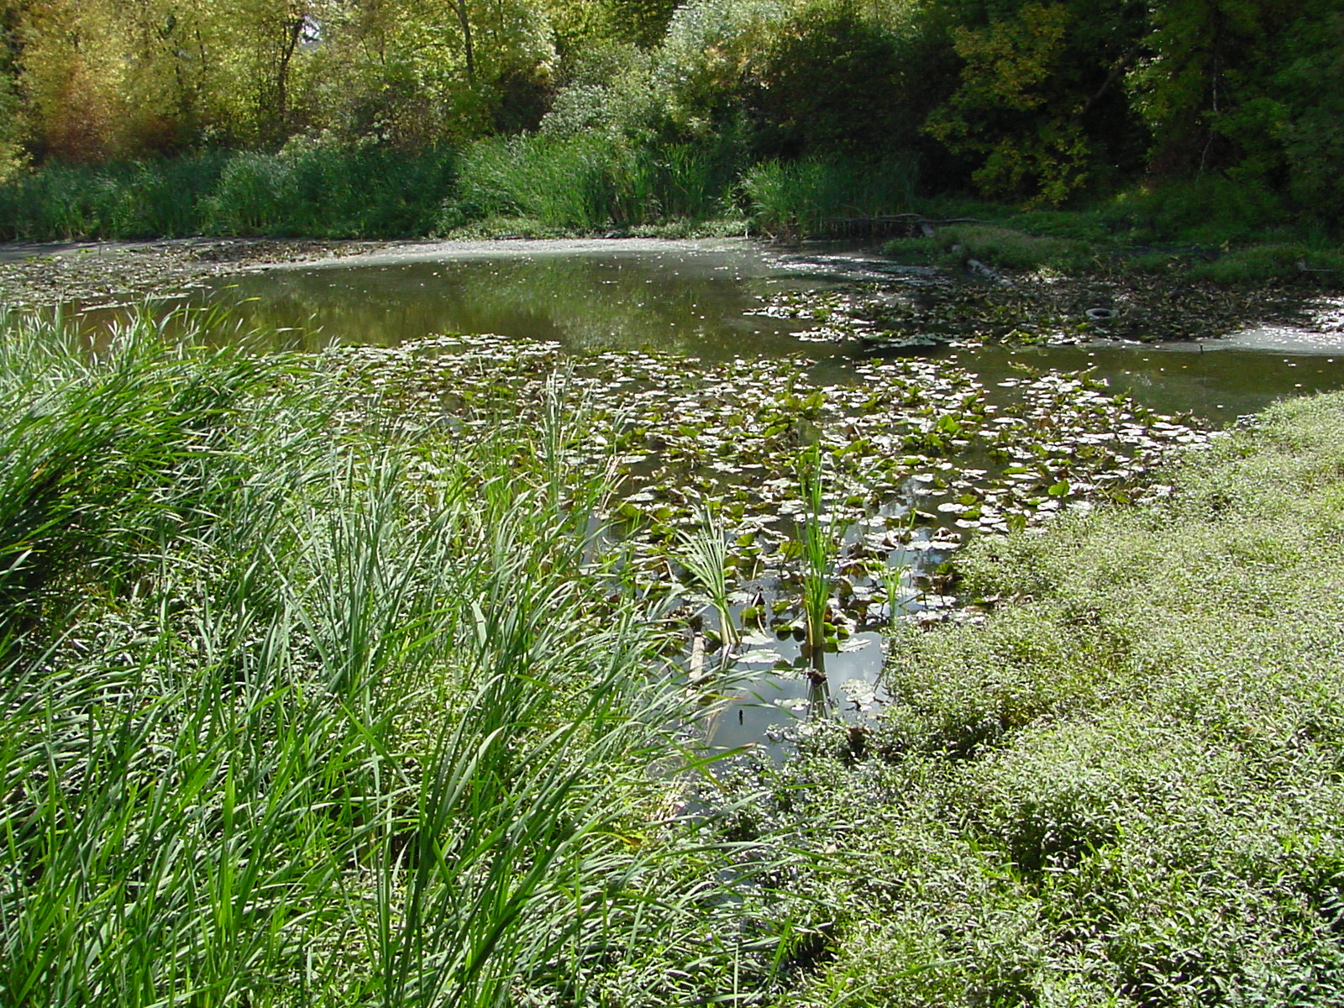
FUTURE SIGNIFICANT STORMWATER PROJECTS
Leach Creek Holding Basin
$4.5M
2023-2024
Approximately 5 Miles of Misc. Underground Pipe Improvements
$61.0M
2023-2028
Manitou Neighborhood Pervious Pavement Project
$3.7M
Larchmont District Pervious Pavement Project
$10.2M
2023
Madison District Green Infrastructure Project
$8.8M
2023

Slide 22
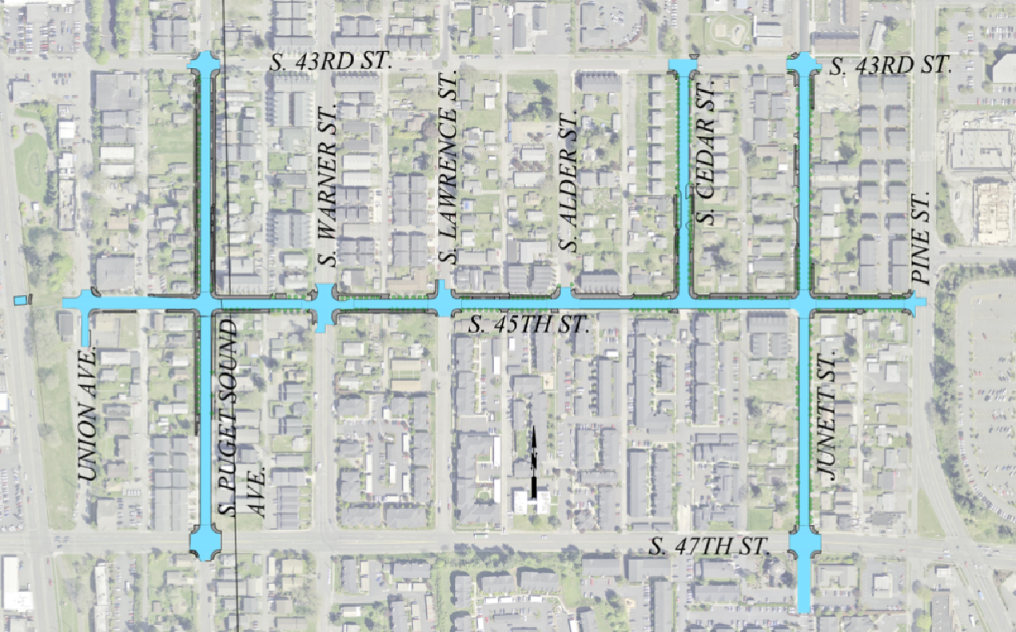
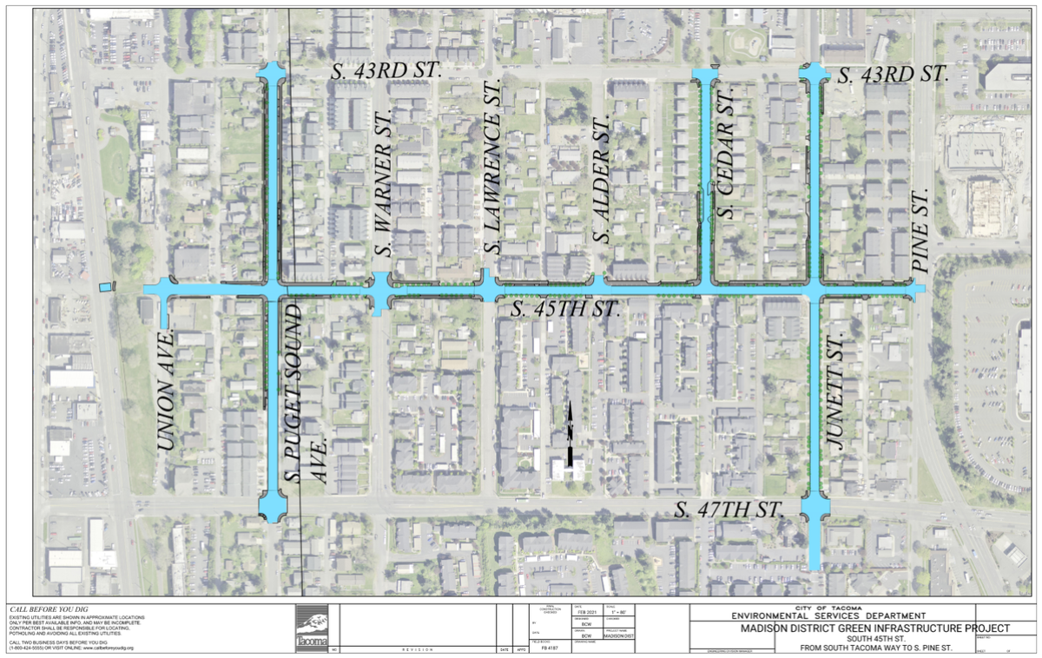
Madison District
Green Infrastructure Project
Notes:
Planned ad date, construction timelines for these projects
Talk about grant money received for these

Slide 23
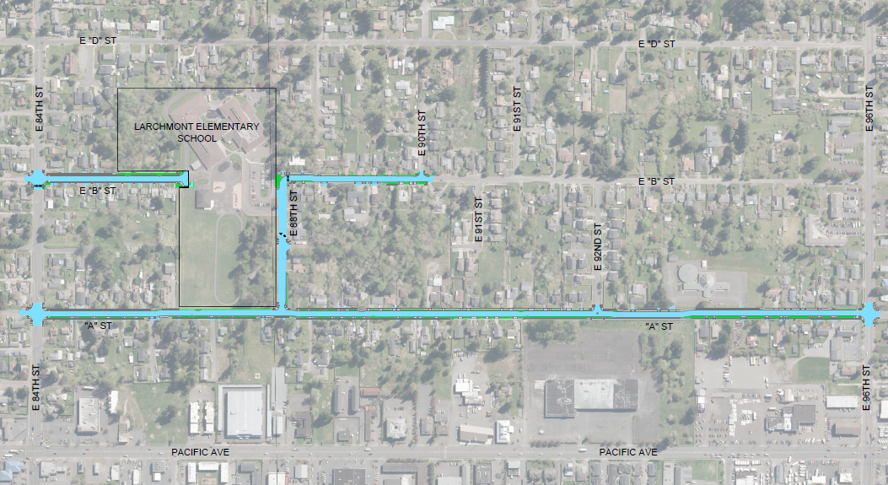
Larchmont District
Green Infrastructure Project

Slide 24
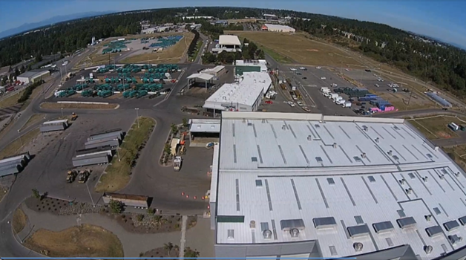
SOLID WASTE CATEGORIES & COSTS
6 Year Total Cost (2023-2028) = $79.6M Annual Average = $13.3M
Environmental Remediation $0.3M
Facility Improvements $14.7M
Special Projects $1.0M
Rolling Stock & Misc. $63.6M

Slide 25
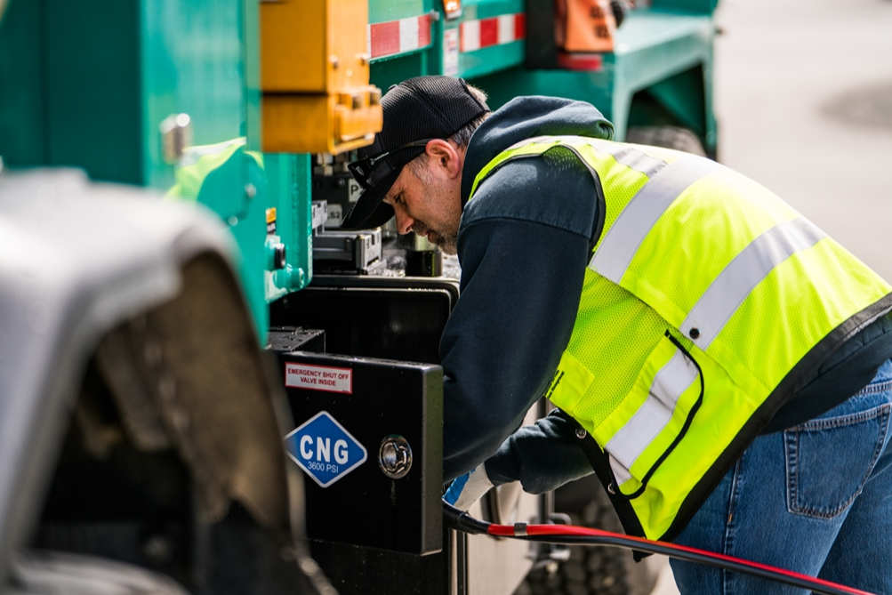
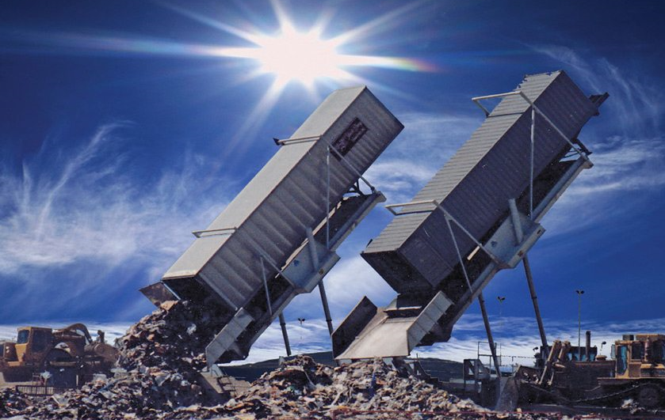
FUTURE SIGNIFICANT SOLID WASTE PROJECTS
Tipping Floor Resurfacing
$0.6M
2024
Downtown Compactors
$1.5M
2022-2024
Electric Charging Stations for Small Fleet Trucks
$2M
2024
Notes:
Tipping Floor Resurfacing – the tipping floor of the Main Receiving Building requires resurfacing every 5-8 years depending on wear. The wear is inspected regularly to determine need for resurfacing. In 2023/24 the budget includes a project to resurface the MRB tipping floor including all associated work and appurtenances necessary including labor, material, equipment, supervision etc. to clean, prepare and install a high performance epoxy floor system.
Electric Charging Station for Small Fleet Trucks – a Citywide study is underway by a consultant to look at number of vehicles and annual mileage to determine the number of vehicle charging stations needed at our facility locations. The consultant work will make a recommendation inclusive of any grant opportunities for funding. The consultant work is planned for completion Summer 2022. The work to install the EV charging stations will be inclusive of all associated civil and electrical work to support the installation of the equipment in the small fleet area of our employee parking lot or determined best site for the stations.
Downtown Compactor Project – the project is to provide replacement compactor enclosures at existing sites located at South 8th and A Court and South 10th and A Court. The work will include at both sites a new enclosure, access control, lighting, drainage and camera systems. The South 8th and A Street site will also include a new enclosure for recycling containers to be placed inside an enclosed area versus their current placement along the sidewalk.
The Master Site Plan will include developing a process to guide decisions on the most suitable end use options for the existing facility operations and closed landfill through stakeholder engagement. The consulting services we obtain through this RFP may also include program development for the following areas (not in any particular order of priority):
Existing and planned infrastructure
Traffic circulation
Future development of electric collection fleet charging station
Existing and new programs and services
New 18 Bay Maintenance Facility Shop Siting/Feasibility Study or potential to expand existing fleet shop into existing welding shop area
Consideration for maintaining existing environmental controls and systems
Consideration for 6 year and longer capital improvement planning
Emergency preparedness
Consideration for existing and future facility operations that reside or desire to reside at the site, both internal to City organization and external developers
Blue Ridge CORE recommendations
Secondary goals as it relates to the site planning effort especially impacts to buffer, access, etc.
End use for adjacent property owned by Environmental Services
Potential development on the landfill cap areas or undeveloped properties own by Environmental Services

Slide 26
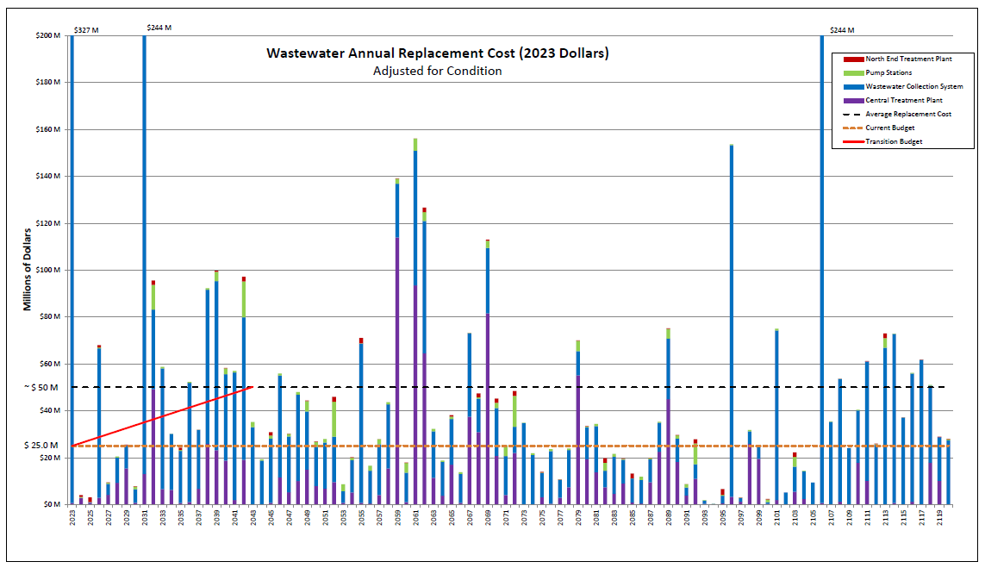
LONG RANGE SPENDING PROJECTIONS
WASTEWATER

Slide 27
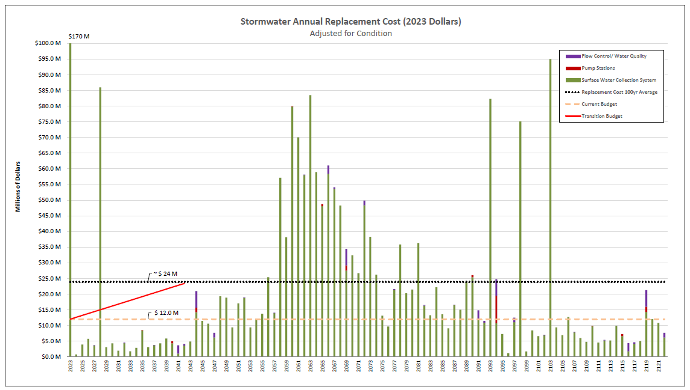
LONG RANGE SPENDING PROJECTIONS
STORMWATER

Slide 28
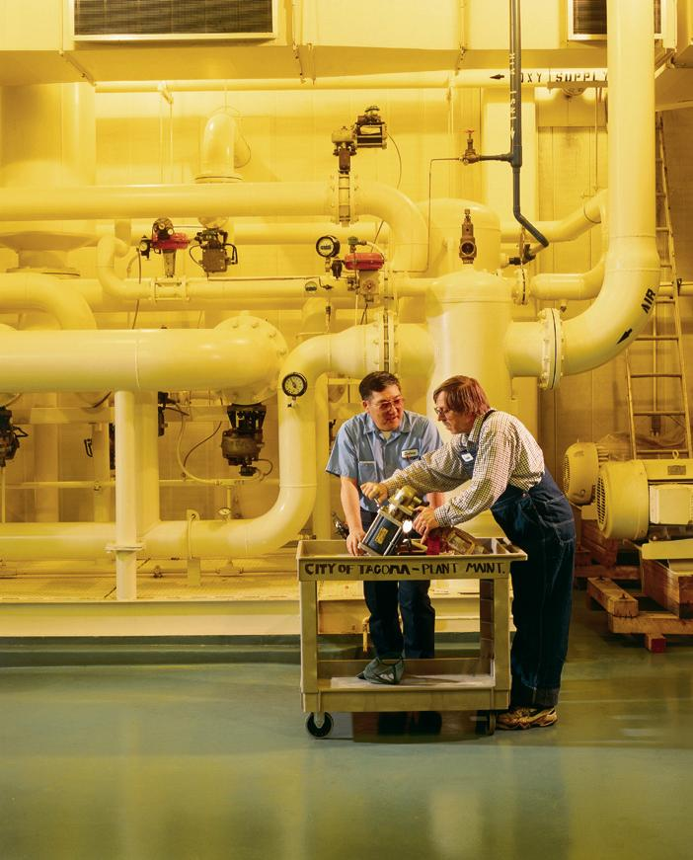
QUESTIONS & DISCUSSION
Contact Information:
  Karen Bartlett, P.E.
  253.502.2257
  kbartlet@cityoftacoma.org
  Teresa Dressler, P.E.
  253.502.2187
  tdressle@cityoftacoma.org
  Lewis Griffith, Division Manager
  253.573.2420
  lgriffit@cityoftacoma.org

Slide 29
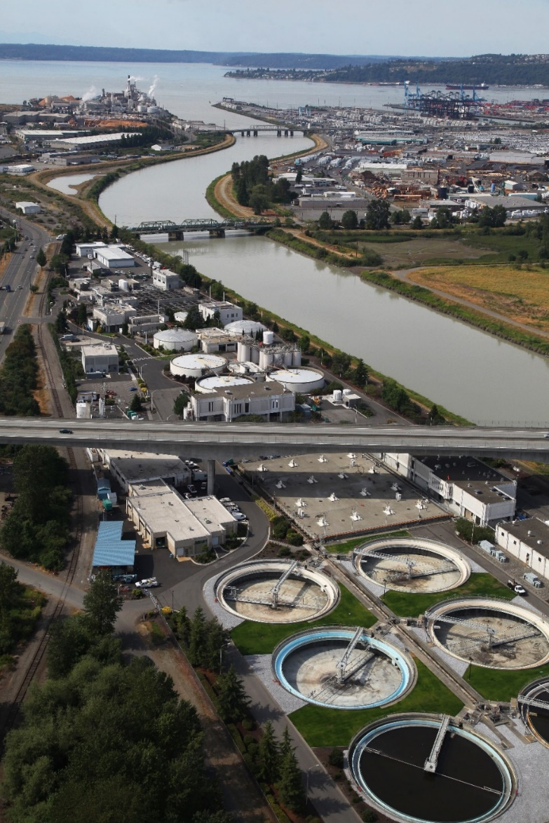
FUTURE WASTEWATER
REGULATION CHANGES
Proposed Regulatory Requirement – Department of Ecology
  NUTRIENT REMOVAL for Wastewater Treatment Plants
  Effluent Limit not finalized, but will impact CIP/Rates at some point in the future
  Will effect Central and North End Wastewater Treatment Plants
  Environmental Services staff are highly engaged in regional partnering with other utilities and the Department of Ecology regarding this upcoming regulation
Notes:
This is an old slide, but wondering if Mike wants to be prepared to talk about this if questions get asked.

Slide 30
Environmental Services Commission
City of Tacoma | Environmental Services Department
Environmental Services Commission
Next Meeting: Thursday, June 9, 2022
Notes:
Template Read-Me
Do not insert animations or slide transitions into your presentation.
Use only sans serif fonts (i.e.: Arial, Tahoma, Helvetica).
Fonts must be between 24 points and 32 points in size. The minimum point size allowed is 18.
Avoid having too much text.
If the text flows outside the safe title area, split the information into two or more slides.
Pictures with white backgrounds should be toned down by right clicking the mouse on the picture, then selecting Format Picture, lower the brightness by 10%.
Ensure graphics (pictures, charts) are high resolution so they can be easily viewed on screen.
The Safe Area grid lines that you see on the background should be removed when your presentation is completely formatted.
To remove the grid lines: Select the View tab. On the left side of the upper tool bar, click on Slide Master. Select the top most slide in the list. (You may need to scroll)
To select the Safe Area we suggest clicking on the upper left corner of the object. Once it highlights, press delete. Save your presentation.
Alternatively you may hide the Safe Area by clicking Hide Background Graphics in the Design tab for each slide in your presentation. (However, make sure this action does not also affect other graphics you have added to your presentation.)

